Slide 1

Note: The data and information in this document is reflective of a hypothetical situation and client. This document is to be used for KPMG Virtual Internship purposes only.
Sprocket Central Pty Ltd
Data analytics approach
Metin Ünlü

Slide 2
Note: The data and information in this document is reflective of a hypothetical situation and client. This document is to be used for KPMG Virtual Internship purposes only.
Agenda
Introduction
Data Exploration
Model Development
Interpretation

Slide 3
Note: The data and information in this document is reflective of a hypothetical situation and client. This document is to be used for KPMG Virtual Internship purposes only.
Introduction
Using Machine Learning To Identify High Value Customer Group
Steps in this data analysis:
Data Quality Assesment
Missing Data Imputation
Exploratory Data Analysis
Customer Segmentation, K-Means Clustering with Machine Learning
Datas at hand:
Transactions
Customer Demograhpic
Customer Adress
New Customer List

Slide 4
Note: The data and information in this document is reflective of a hypothetical situation and client. This document is to be used for KPMG Virtual Internship purposes only.
Data Exploration
Exploratory data analysis: critical process of performing initial investigations on data so as to discover patterns,to spot anomalies,to test hypothesis and to check assumptions with the help of summary statistics and graphical representations.

Slide 5
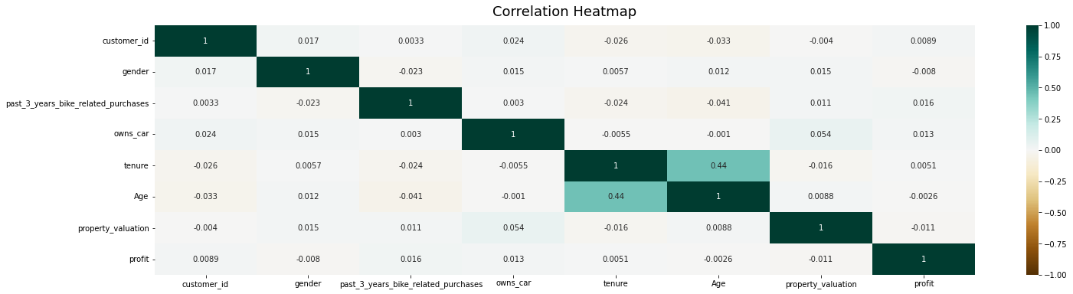
Note: The data and information in this document is reflective of a hypothetical situation and client. This document is to be used for KPMG Virtual Internship purposes only.
Data Exploration
Multiclass Correlation Graph
A easy way to find correlation is to use heat map but the range of values differ considerably, thus data is studied step by step as shown in following slides:

Slide 6
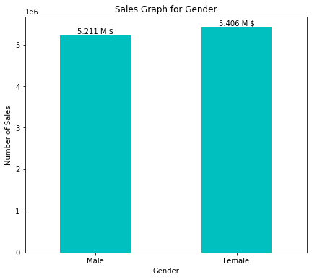
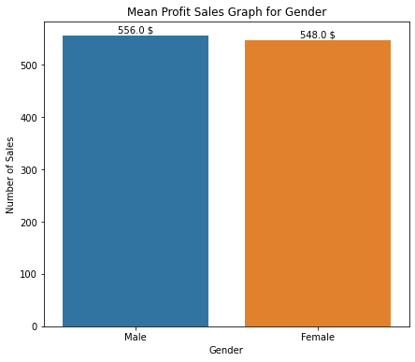
Note: The data and information in this document is reflective of a hypothetical situation and client. This document is to be used for KPMG Virtual Internship purposes only.
Data Exploration
Genders
Both gender generates similar amount of profit and has around the same mean profit from sales.

Slide 7
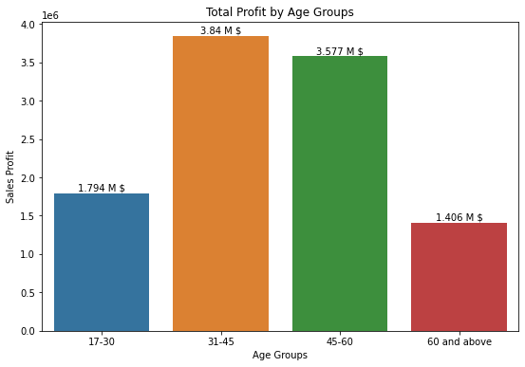
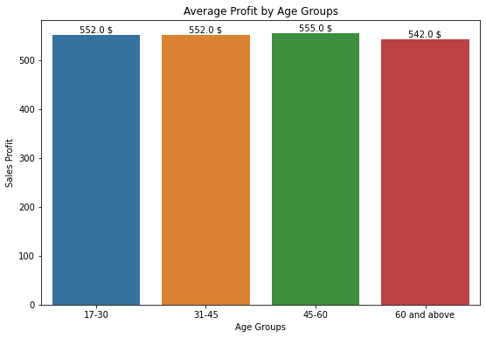
Note: The data and information in this document is reflective of a hypothetical situation and client. This document is to be used for KPMG Virtual Internship purposes only.
Data Exploration
Age Groups
In total, age groups of 31-45 and 45-60 generates highest profit. Overall, each sales profit for each age group is around same values.

Slide 8
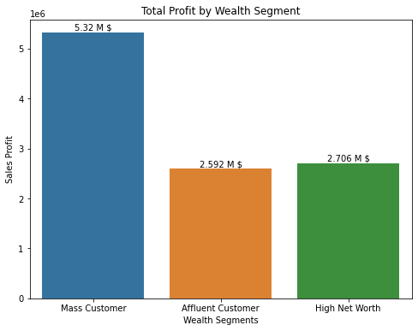
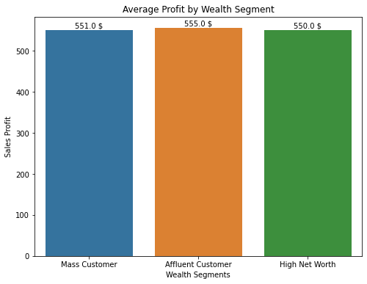
Note: The data and information in this document is reflective of a hypothetical situation and client. This document is to be used for KPMG Virtual Internship purposes only.
Data Exploration
Wealth Segments
In total, mass customer wealth segment generates highest profit. Overall, each sales profit for each wealth segment is around same values.

Slide 9
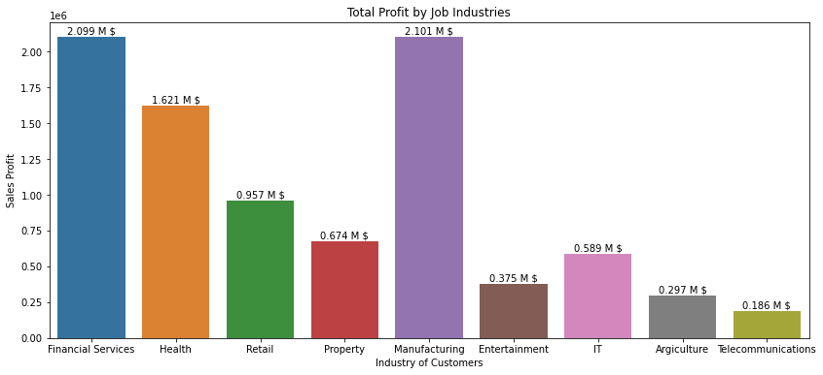
Note: The data and information in this document is reflective of a hypothetical situation and client. This document is to be used for KPMG Virtual Internship purposes only.
Data Exploration
By Industry
In total, manufacturing and financial services generates highest sales.

Slide 10
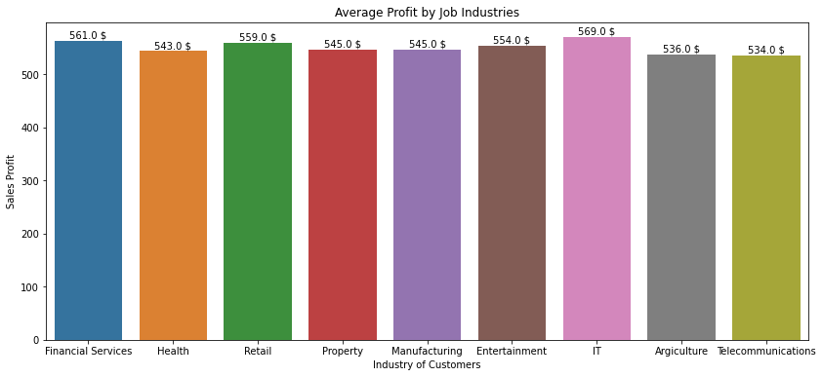
Note: The data and information in this document is reflective of a hypothetical situation and client. This document is to be used for KPMG Virtual Internship purposes only.
Data Exploration
By Industry
Overall, each sales profit for each industry is around same values.

Slide 11
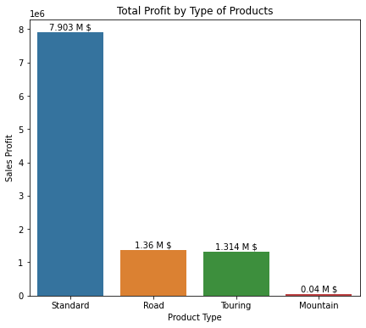
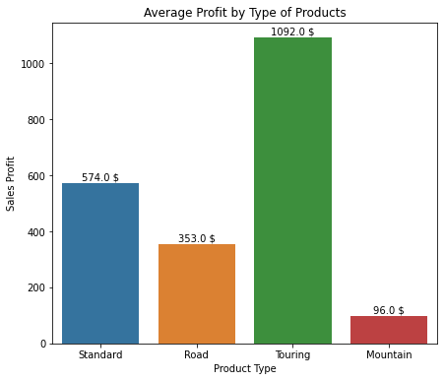
Note: The data and information in this document is reflective of a hypothetical situation and client. This document is to be used for KPMG Virtual Internship purposes only.
Data Exploration
Type of Products
In total, standart type of products hugely populates the transaction and generates highest sales profit.
However, average profit made from touring bikes is highest. Touring bikes, thus, generates highest return with lower investment budget.

Slide 12
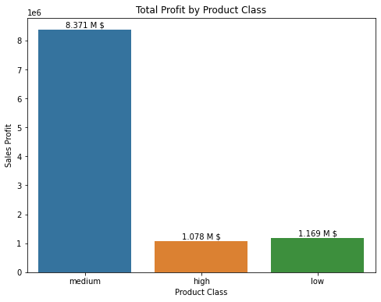
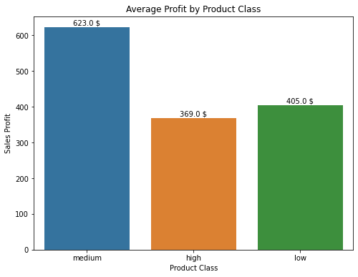
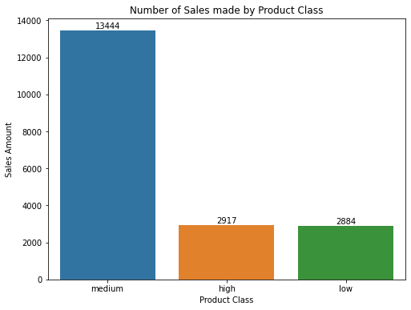
Note: The data and information in this document is reflective of a hypothetical situation and client. This document is to be used for KPMG Virtual Internship purposes only.
Data Exploration
Product Class
In total, medium class products generates highest profit. Overall, medium class products also has higher profit per sales.

Slide 13
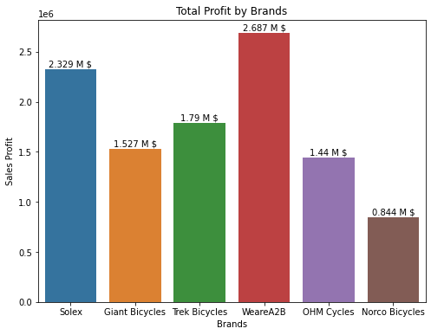
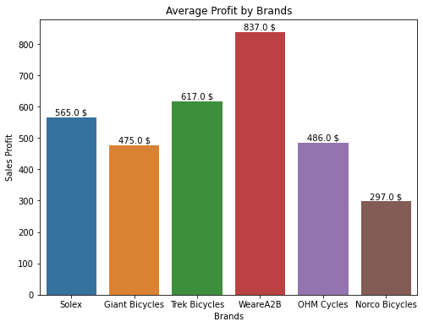
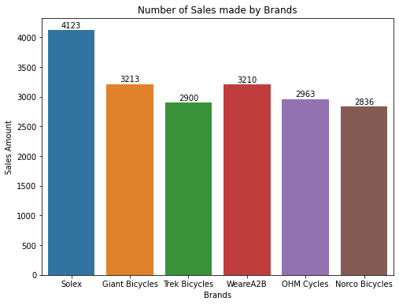
Note: The data and information in this document is reflective of a hypothetical situation and client. This document is to be used for KPMG Virtual Internship purposes only.
Data Exploration
Brand
Solex have the highest number of sales. However both total profit and average profit for WeareA2B is highest from any other brand. People are willing to spend more money on WeareA2B.

Slide 14
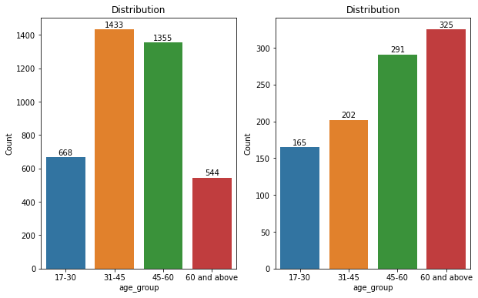
Note: The data and information in this document is reflective of a hypothetical situation and client. This document is to be used for KPMG Virtual Internship purposes only.
Data Exploration
Old and New Customers - Age
Age distribution have changed drastically between old and new customers. Remember that we have shown average sales profit from different age groups were identical. With that in mind, with new customers, to capture them, advertisements and presentation of the products can be changed to the interest of middle-aged adults and old adults.

Slide 15
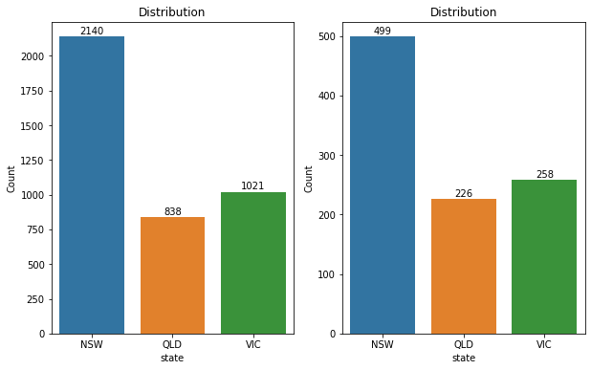
Note: The data and information in this document is reflective of a hypothetical situation and client. This document is to be used for KPMG Virtual Internship purposes only.
Data Exploration
Old and New Customers - State
No mentionable change between old and new customers regarding the state customers live in.

Slide 16
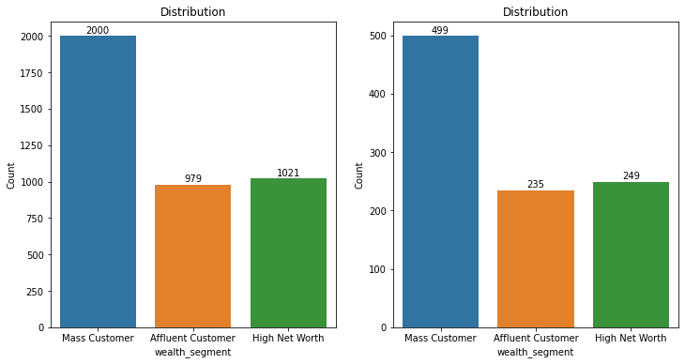
Note: The data and information in this document is reflective of a hypothetical situation and client. This document is to be used for KPMG Virtual Internship purposes only.
Data Exploration
Old and New Customers – Wealth Segment
No mentionable change between old and new customers regarding the wealth segment of the customers.

Slide 17
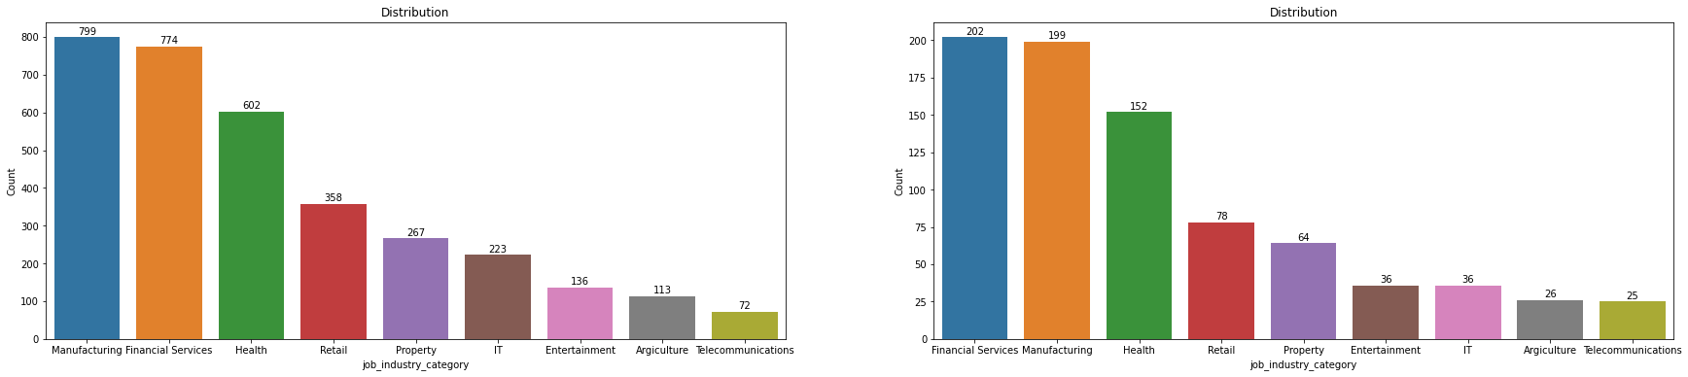
Note: The data and information in this document is reflective of a hypothetical situation and client. This document is to be used for KPMG Virtual Internship purposes only.
Data Exploration
Old and New Customers – Industry
Some of the industries have slightly changed but there is no drastically difference.

Slide 18
Note: The data and information in this document is reflective of a hypothetical situation and client. This document is to be used for KPMG Virtual Internship purposes only.
Model Development
K-Means Clustering w/ Machine Learning
There are different methods to use data for a business plan. Main objective here is customer segmentation. This can be done in different ways, the method utilized in this data set is K-Means Clustering.
K Means Clustering Algorithm
Specify number of clusters K.
Initialize centroids by first shuffling the dataset and then randomly selecting K data points for the centroids without replacement.
Keep iterating until there is no change to the centroids. i.e assignment of data points to clusters isn’t changing.

Slide 19
Note: The data and information in this document is reflective of a hypothetical situation and client. This document is to be used for KPMG Virtual Internship purposes only.
Model Development
K-Means Algorithm is modeled with following columns:
Past 3 years bike related purchases
Age
Tenure
Property valuation
Profit

Slide 20
Note: The data and information in this document is reflective of a hypothetical situation and client. This document is to be used for KPMG Virtual Internship purposes only.
Model Development
The data modeled with machine learning:
 | past 3 years bike related purchases | Age | tenure | property valuation | profit |  | owns car | Affluent Customer | High Net Worth | Mass Customer
ClusterLabel | mean | mean | mean | mean | sum | mean | mean | mean | mean | mean
0 | 50,3 | 28,8 | 3,8 | 7,7 | $2.095.120,50 | $493,20 | 0,5 | 0,3 | 0,2 | 0,5
1 | 46,5 | 49,1 | 12,6 | 3 | $1.281.487,90 | $432,80 | 0,4 | 0,2 | 0,3 | 0,5
2 | 24,3 | 50,2 | 13,1 | 8,8 | $1.557.879,00 | $324,20 | 0,5 | 0,2 | 0,2 | 0,5
3 | 77,5 | 49,7 | 12,4 | 8,8 | $1.471.544,70 | $353,10 | 0,5 | 0,2 | 0,3 | 0,5
4 | 48,3 | 48 | 12,1 | 7,9 | $4.211.035,60 | $1.374,80 | 0,5 | 0,2 | 0,3 | 0,5
However boring it may look, lets investigate what the machine learning have found from the distribution and how it has created cluster groups.

Slide 21
Note: The data and information in this document is reflective of a hypothetical situation and client. This document is to be used for KPMG Virtual Internship purposes only.
Model Development
 | past 3 years bike related purchases | Age | tenure | property valuation | profit |  | owns car | Affluent Customer | High Net Worth | Mass Customer
ClusterLabel | mean | mean | mean | mean | sum | mean | mean | mean | mean | mean
0 | 50,3 | 28,8 | 3,8 | 7,7 | $2.095.120,50 | $493,20 | 0,5 | 0,3 | 0,2 | 0,5
1 | 46,5 | 49,1 | 12,6 | 3 | $1.281.487,90 | $432,80 | 0,4 | 0,2 | 0,3 | 0,5
2 | 24,3 | 50,2 | 13,1 | 8,8 | $1.557.879,00 | $324,20 | 0,5 | 0,2 | 0,2 | 0,5
3 | 77,5 | 49,7 | 12,4 | 8,8 | $1.471.544,70 | $353,10 | 0,5 | 0,2 | 0,3 | 0,5
4 | 48,3 | 48 | 12,1 | 7,9 | $4.211.035,60 | $1.374,80 | 0,5 | 0,2 | 0,3 | 0,5
Cluster 4 - Most valuable customer group
This group must be the main focus. Highest amount of sales profit achieving customer group. They are frequent purchaser, middle-aged adult with high property valuation and tenure. In average, this customer group also has higher profit mean.

Slide 22
Note: The data and information in this document is reflective of a hypothetical situation and client. This document is to be used for KPMG Virtual Internship purposes only.
Model Development
 | past 3 years bike related purchases | Age | tenure | property valuation | profit |  | owns car | Affluent Customer | High Net Worth | Mass Customer
ClusterLabel | mean | mean | mean | mean | sum | mean | mean | mean | mean | mean
0 | 50,3 | 28,8 | 3,8 | 7,7 | $2.095.120,50 | $493,20 | 0,5 | 0,3 | 0,2 | 0,5
1 | 46,5 | 49,1 | 12,6 | 3 | $1.281.487,90 | $432,80 | 0,4 | 0,2 | 0,3 | 0,5
2 | 24,3 | 50,2 | 13,1 | 8,8 | $1.557.879,00 | $324,20 | 0,5 | 0,2 | 0,2 | 0,5
3 | 77,5 | 49,7 | 12,4 | 8,8 | $1.471.544,70 | $353,10 | 0,5 | 0,2 | 0,3 | 0,5
4 | 48,3 | 48 | 12,1 | 7,9 | $4.211.035,60 | $1.374,80 | 0,5 | 0,2 | 0,3 | 0,5
Cluster 0 - Valuable customer group
Second highest profitable customer group. They are young people with low tenure. These young people has high property valuation, hinting they are from wealthy families. These young adults must be attracted with advertisements for increasing profit.

Slide 23
Note: The data and information in this document is reflective of a hypothetical situation and client. This document is to be used for KPMG Virtual Internship purposes only.
Model Development
 | past 3 years bike related purchases | Age | tenure | property valuation | profit |  | owns car | Affluent Customer | High Net Worth | Mass Customer
ClusterLabel | mean | mean | mean | mean | sum | mean | mean | mean | mean | mean
0 | 50,3 | 28,8 | 3,8 | 7,7 | $2.095.120,50 | $493,20 | 0,5 | 0,3 | 0,2 | 0,5
1 | 46,5 | 49,1 | 12,6 | 3 | $1.281.487,90 | $432,80 | 0,4 | 0,2 | 0,3 | 0,5
2 | 24,3 | 50,2 | 13,1 | 8,8 | $1.557.879,00 | $324,20 | 0,5 | 0,2 | 0,2 | 0,5
3 | 77,5 | 49,7 | 12,4 | 8,8 | $1.471.544,70 | $353,10 | 0,5 | 0,2 | 0,3 | 0,5
4 | 48,3 | 48 | 12,1 | 7,9 | $4.211.035,60 | $1.374,80 | 0,5 | 0,2 | 0,3 | 0,5
Cluster 2 - Keep in touch
People who makes bike purchases least amount. These people are not frequent buyers, but its important to keep in touch with these group as they generate considerable profit nevertheless.

Slide 24
Note: The data and information in this document is reflective of a hypothetical situation and client. This document is to be used for KPMG Virtual Internship purposes only.
Model Development
 | past 3 years bike related purchases | Age | tenure | property valuation | profit |  | owns car | Affluent Customer | High Net Worth | Mass Customer
ClusterLabel | mean | mean | mean | mean | sum | mean | mean | mean | mean | mean
0 | 50,3 | 28,8 | 3,8 | 7,7 | $2.095.120,50 | $493,20 | 0,5 | 0,3 | 0,2 | 0,5
1 | 46,5 | 49,1 | 12,6 | 3 | $1.281.487,90 | $432,80 | 0,4 | 0,2 | 0,3 | 0,5
2 | 24,3 | 50,2 | 13,1 | 8,8 | $1.557.879,00 | $324,20 | 0,5 | 0,2 | 0,2 | 0,5
3 | 77,5 | 49,7 | 12,4 | 8,8 | $1.471.544,70 | $353,10 | 0,5 | 0,2 | 0,3 | 0,5
4 | 48,3 | 48 | 12,1 | 7,9 | $4.211.035,60 | $1.374,80 | 0,5 | 0,2 | 0,3 | 0,5
Cluster 3 - Frequent Purchasers
These people may not generate high profit but are the most frequent buyers. It is profitable to constantly send them reminders, advertisements, sales mail and other reaching methods to keep them on constant buyer state.

Slide 25
Note: The data and information in this document is reflective of a hypothetical situation and client. This document is to be used for KPMG Virtual Internship purposes only.
Model Development
 | past 3 years bike related purchases | Age | tenure | property valuation | profit |  | owns car | Affluent Customer | High Net Worth | Mass Customer
ClusterLabel | mean | mean | mean | mean | sum | mean | mean | mean | mean | mean
0 | 50,3 | 28,8 | 3,8 | 7,7 | $2.095.120,50 | $493,20 | 0,5 | 0,3 | 0,2 | 0,5
1 | 46,5 | 49,1 | 12,6 | 3 | $1.281.487,90 | $432,80 | 0,4 | 0,2 | 0,3 | 0,5
2 | 24,3 | 50,2 | 13,1 | 8,8 | $1.557.879,00 | $324,20 | 0,5 | 0,2 | 0,2 | 0,5
3 | 77,5 | 49,7 | 12,4 | 8,8 | $1.471.544,70 | $353,10 | 0,5 | 0,2 | 0,3 | 0,5
4 | 48,3 | 48 | 12,1 | 7,9 | $4.211.035,60 | $1.374,80 | 0,5 | 0,2 | 0,3 | 0,5
Cluster 1 - Low revenue customers
These people mainly live in low value property. Lowest revenue generating group. Should be last group to consider during advertisement budgetting.

Slide 26
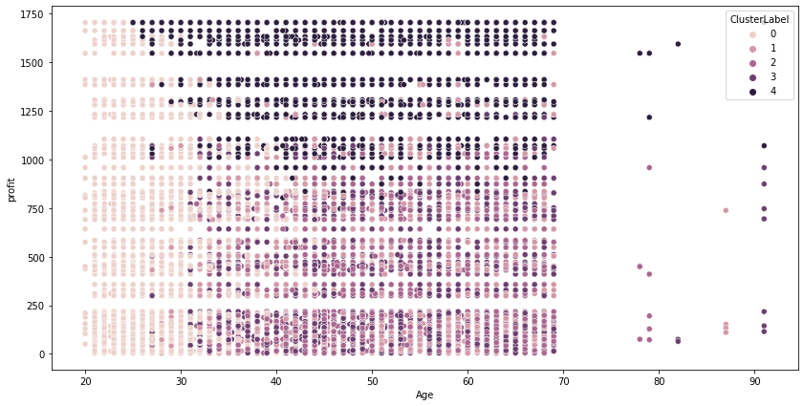
Note: The data and information in this document is reflective of a hypothetical situation and client. This document is to be used for KPMG Virtual Internship purposes only.
Model Development
Cluster Scatter Plot
Distribution of customers depending on their age and the transaction they have made

Slide 27
Note: The data and information in this document is reflective of a hypothetical situation and client. This document is to be used for KPMG Virtual Internship purposes only.
Interpretation
We have discused numerous point from the information gathered on data. To summarize hightakes:
Job industry of financial services and manufacturing generates highest total sales profit.
Mass customers generates highest total sales profit.
Standard type products sales the most.
Touring type products have the highest average profit.
Medium product class have highest total sales profit and average sales profit.

Slide 28
Note: The data and information in this document is reflective of a hypothetical situation and client. This document is to be used for KPMG Virtual Internship purposes only.
Interpretation
WeareA2B products have highest total sales profit and average sales profit.
New customers are middle-aged adults and old adults, change advertisement tactics fittingly.
Mainly target Cluster 4 group customers for highest sales profit generation.
Follow Cluster 4 with Cluster 0 to increase sales profit.

Slide 29
Note: The data and information in this document is reflective of a hypothetical situation and client. This document is to be used for KPMG Virtual Internship purposes only.
Appendix

Slide 30
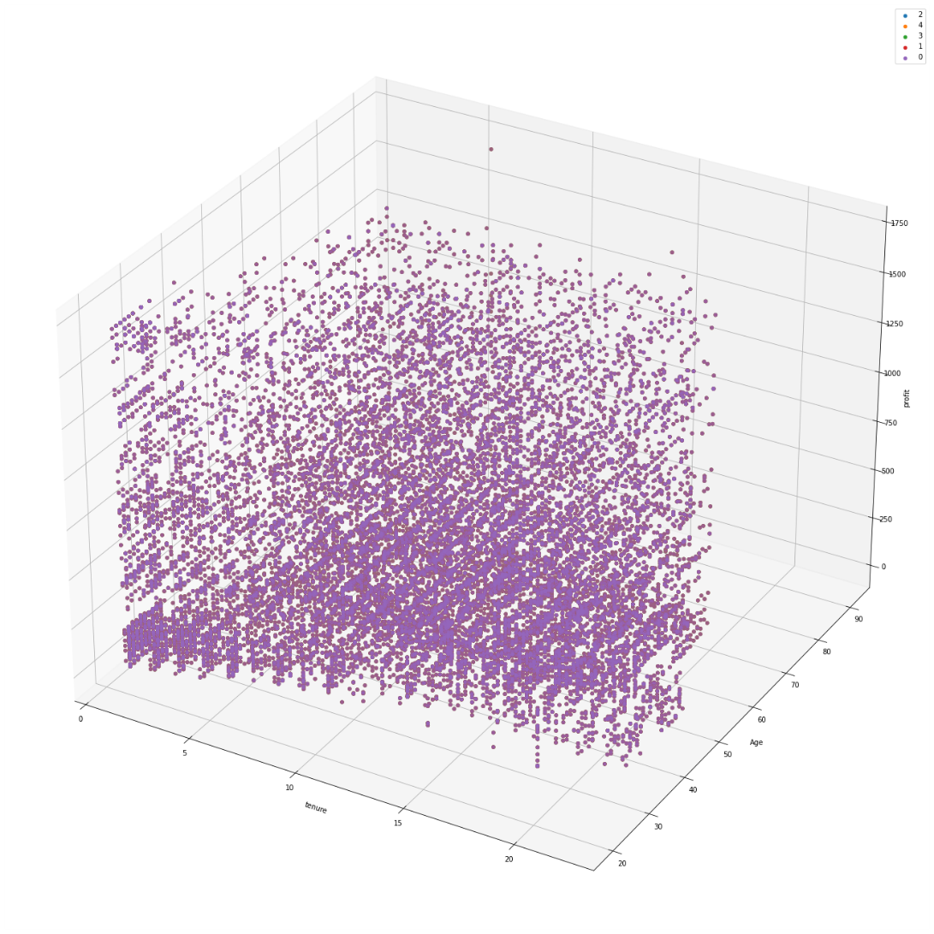
Note: The data and information in this document is reflective of a hypothetical situation and client. This document is to be used for KPMG Virtual Internship purposes only.
Appendix
tenure & age & profit
Scatter plot

Slide 31
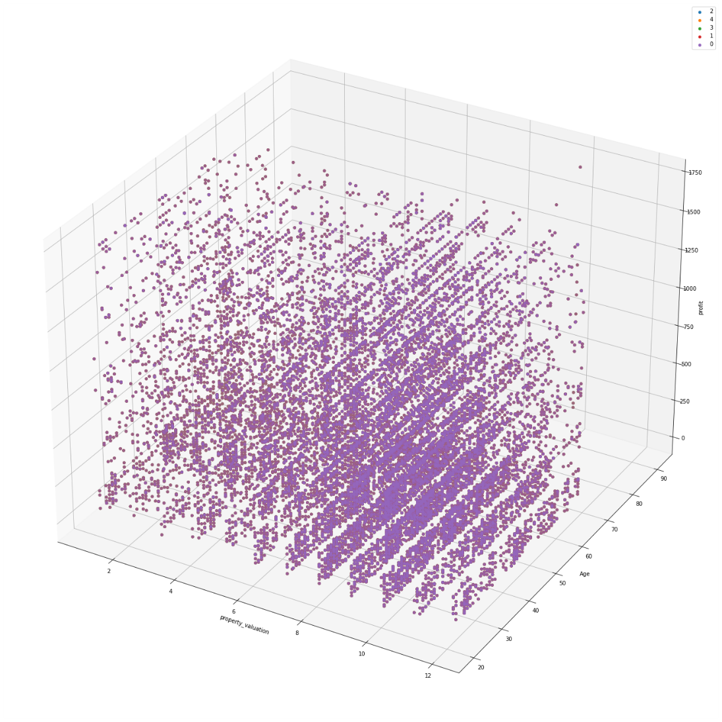
Note: The data and information in this document is reflective of a hypothetical situation and client. This document is to be used for KPMG Virtual Internship purposes only.
Appendix
property_valuation & age & profit
Scatter plot

Slide 32
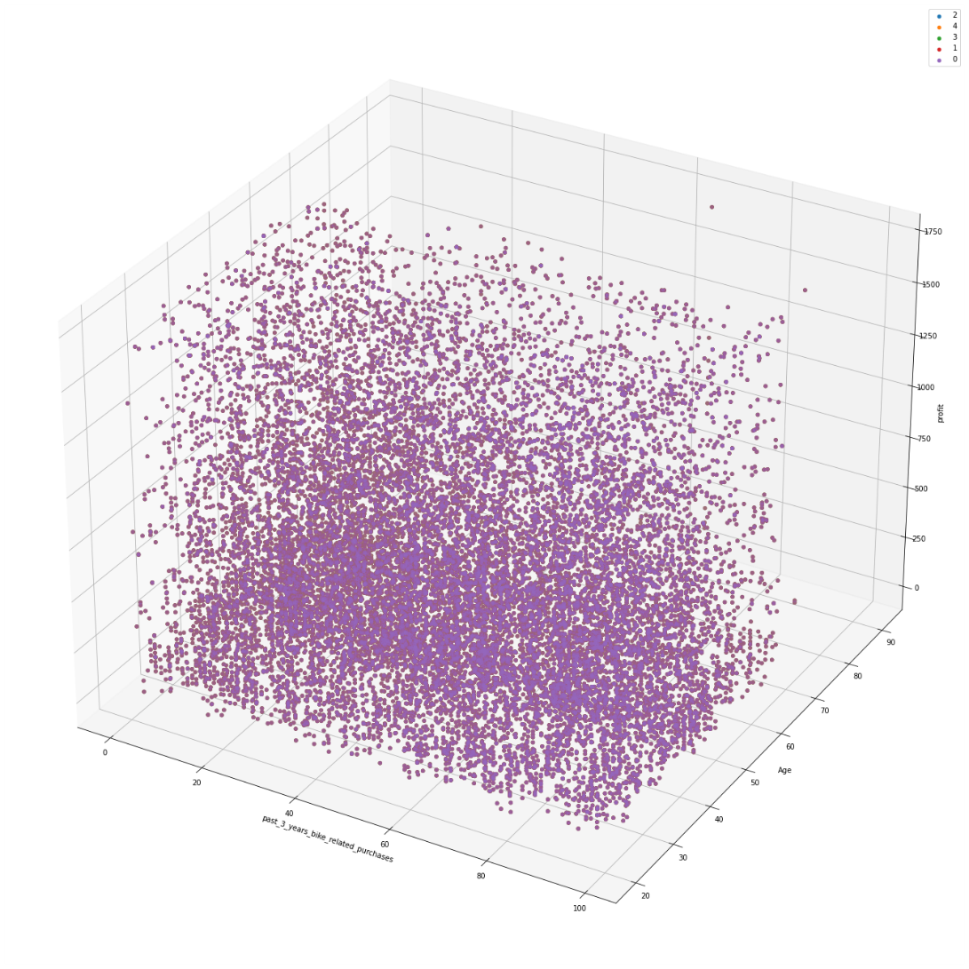
Note: The data and information in this document is reflective of a hypothetical situation and client. This document is to be used for KPMG Virtual Internship purposes only.
Appendix
past3years & age & profit
Scatter plot

Slide 33
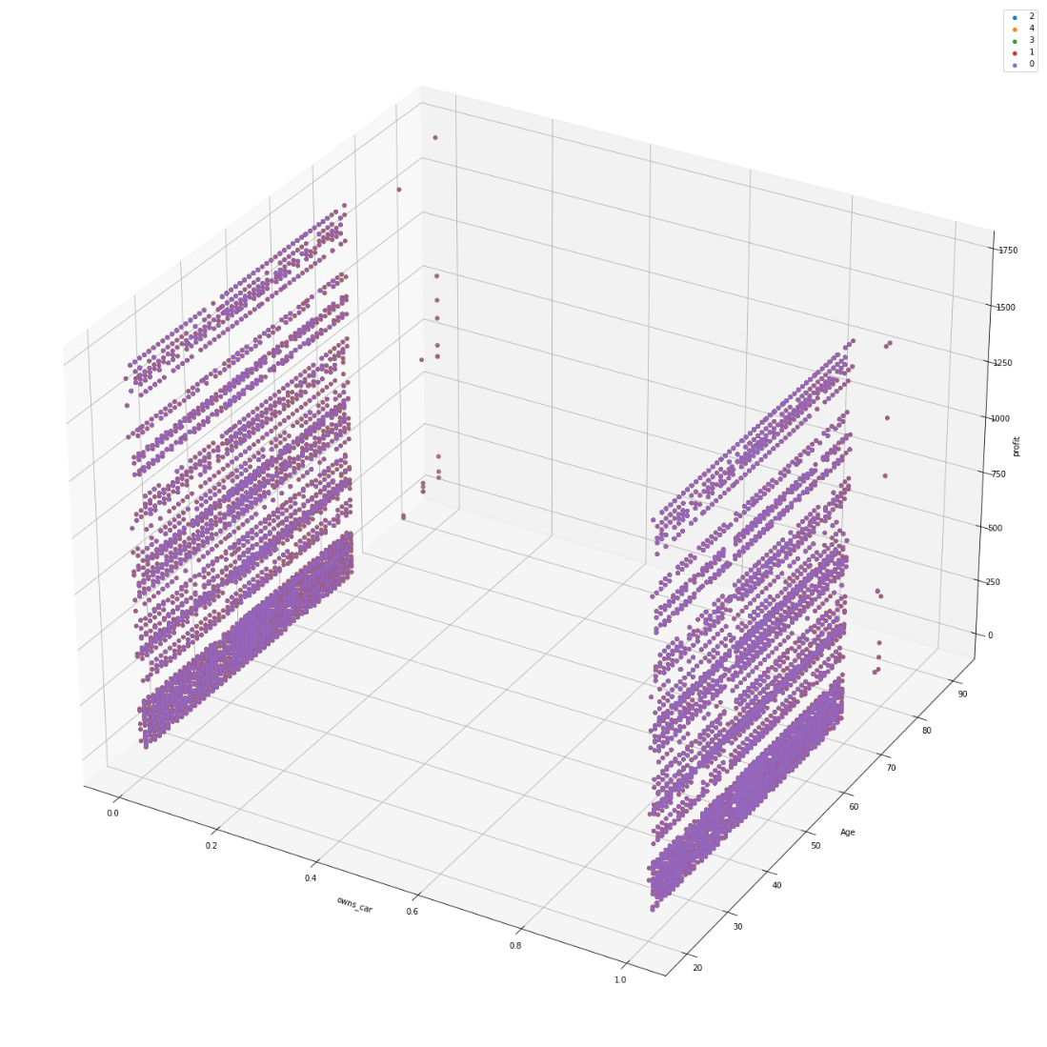
Note: The data and information in this document is reflective of a hypothetical situation and client. This document is to be used for KPMG Virtual Internship purposes only.
Appendix
owns_car & age & profit
Scatter plot

Slide 34
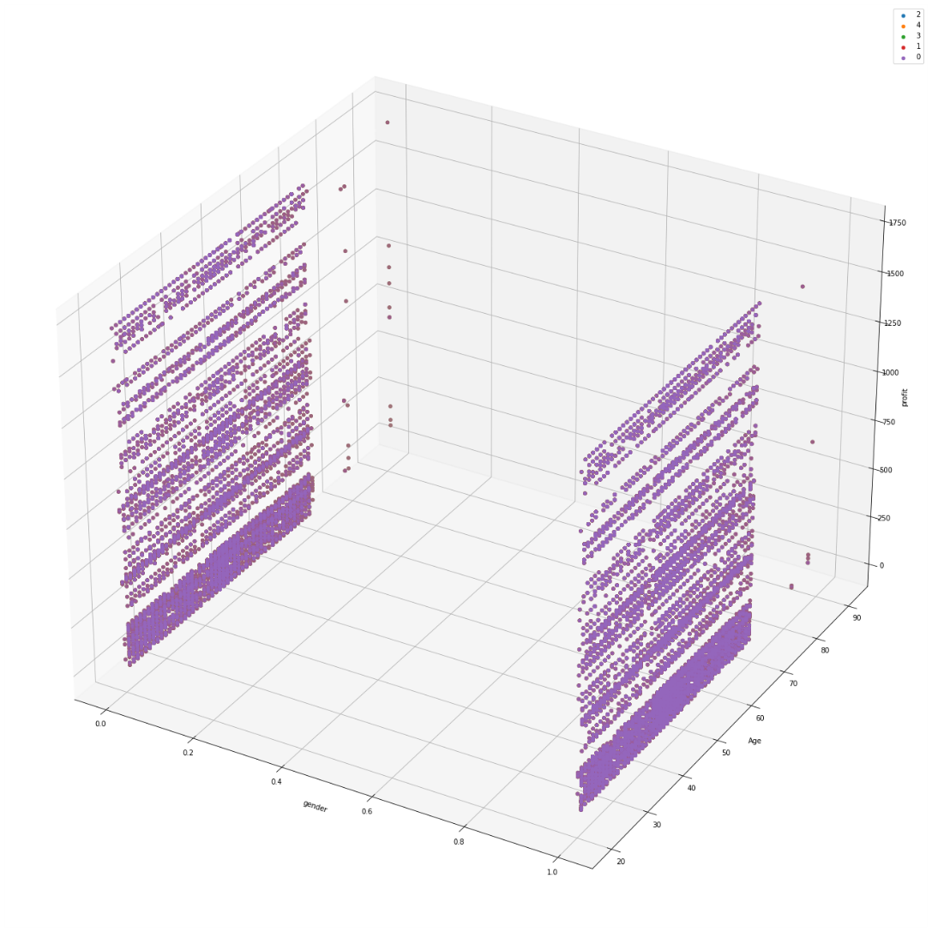
Note: The data and information in this document is reflective of a hypothetical situation and client. This document is to be used for KPMG Virtual Internship purposes only.
Appendix
gender & age & profit
Scatter plot

